Slide 1

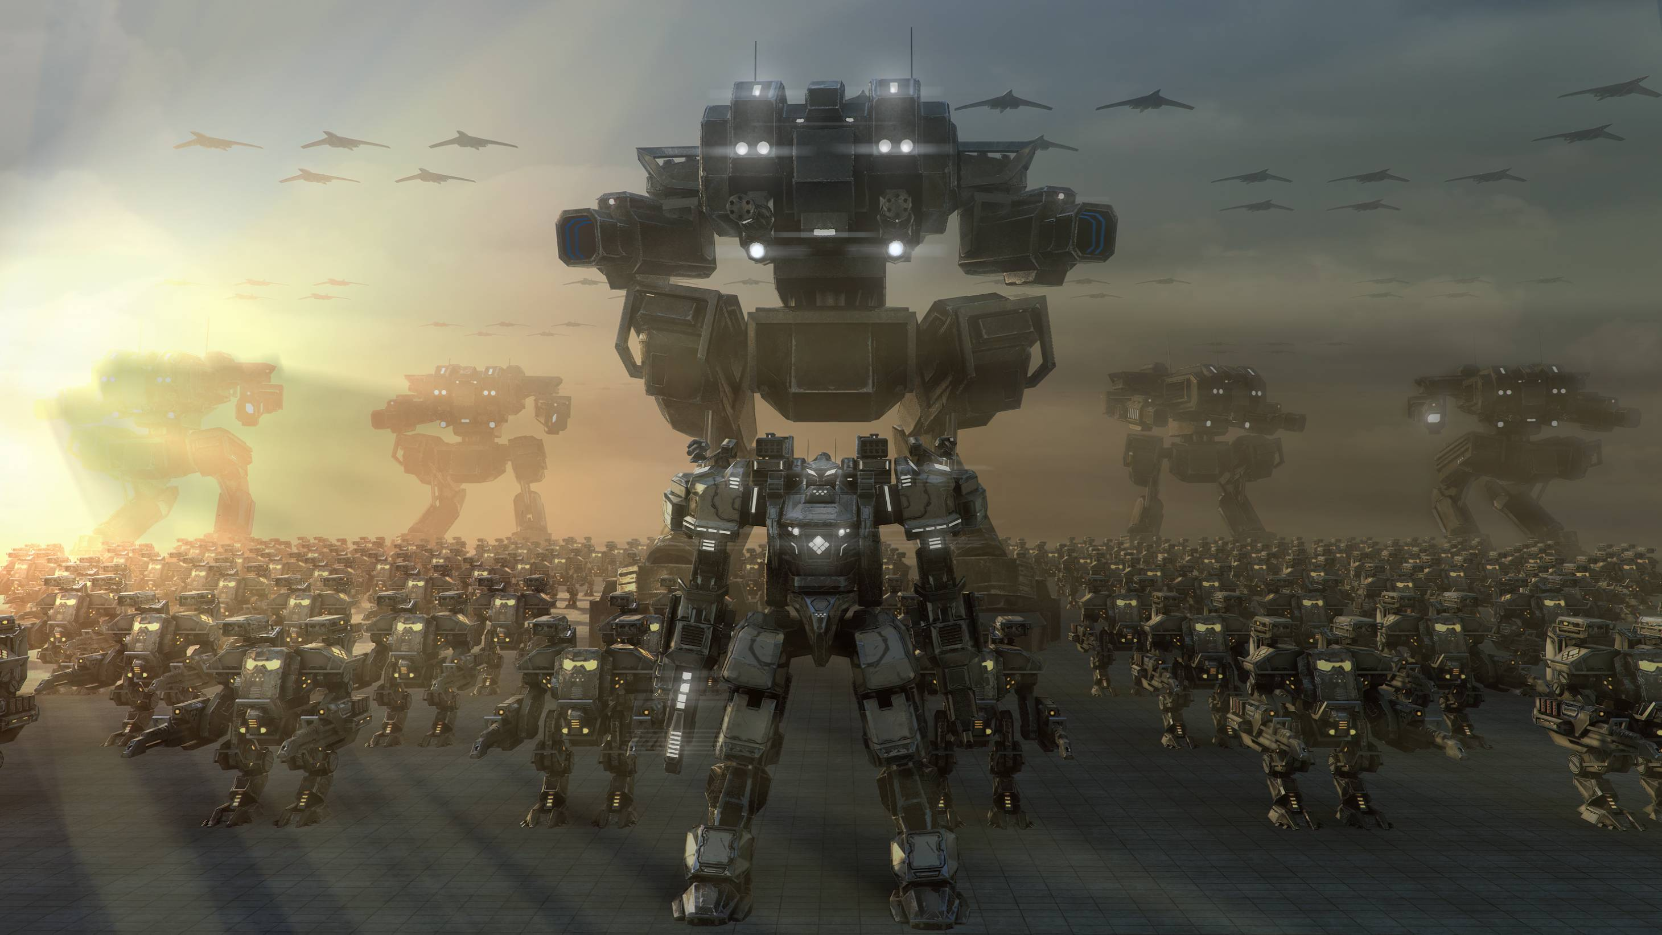
MACHINE LEARNING DEPLOYMENT 101
ENGINEERING MACHINE LEARNING
HEALTH TECHNOLOGY

Slide 2
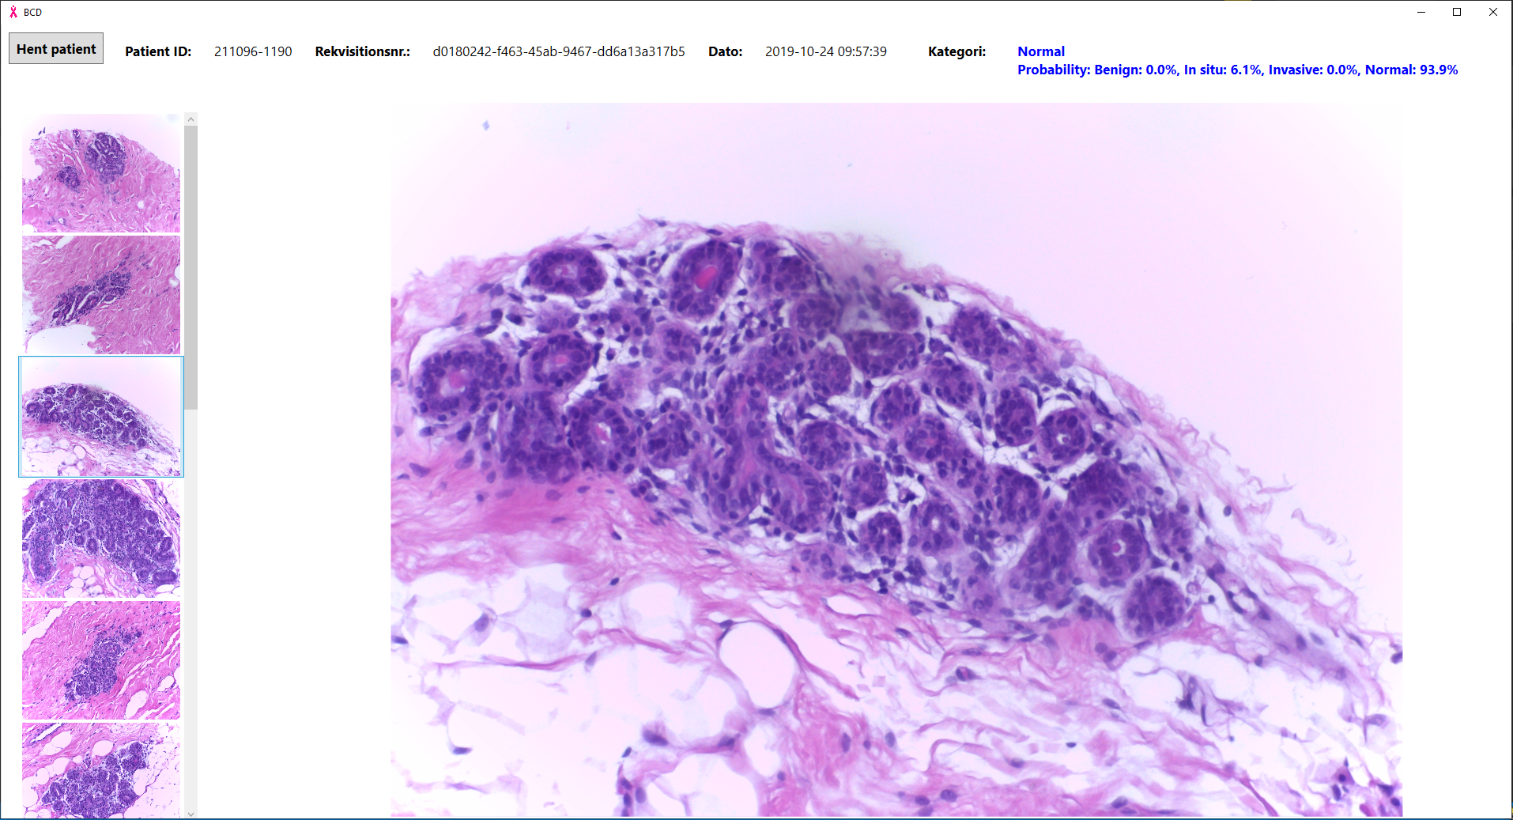
DEPLOYMENT 101
So you have designed, implemented, trained and tested your machine learning model – and you are happy with its robustness – now what?
Deployment!
Many options..
Bachelor project

Slide 3
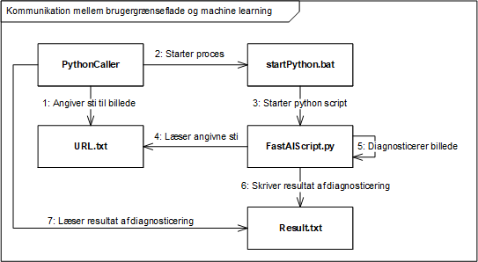
DEPLOYMENT 101
So you have designed, implemented, trained and tested your machine learning model – and you are happy with its robustness – now what?
Deployment!
Many options..
Bachelor project

Slide 4
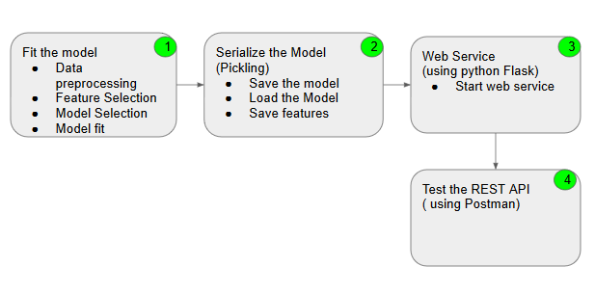
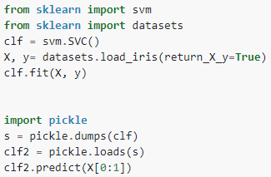
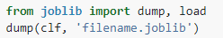
DEPLOYMENT 101
So you have designed, implemented, trained and tested your machine learning model – and you are happy with its robustness – now what?
Deployment!
Many options..
or into a file:
https://scikit-learn.org/stable/modules/model_persistence.html
https://towardsdatascience.com/machine-learning-model-deployment-as-rest-api-in-four-easy-steps-e65764f7c5c

Slide 5
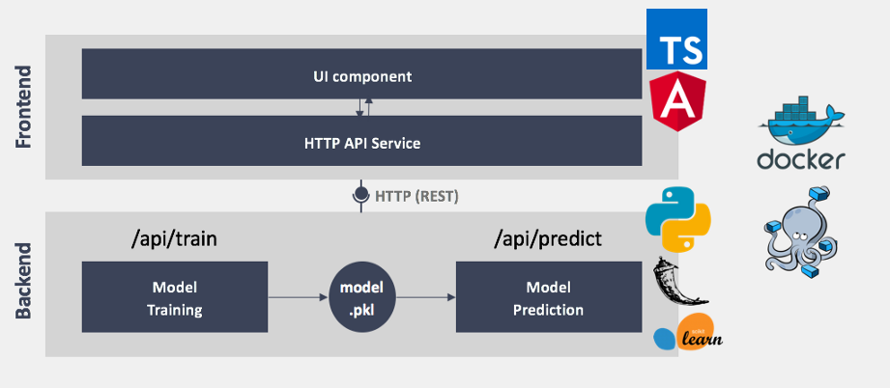
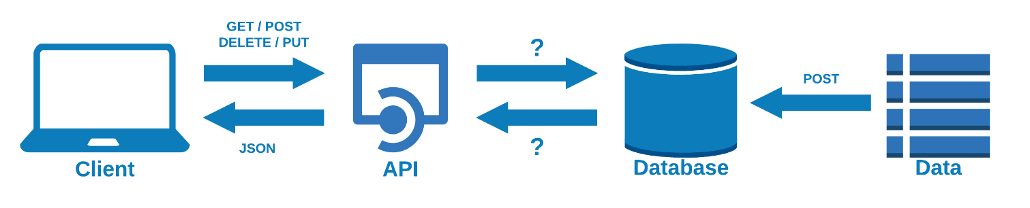
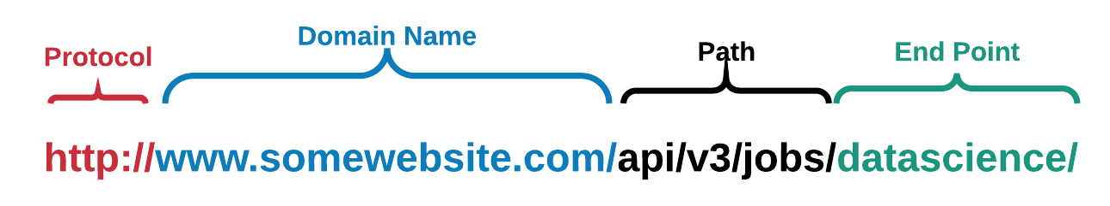
DEPLOYMENT 101
WEB REST API
2
1
3
https://medium.com/analytics-vidhya/building-flask-rest-app-with-flask-restful-d22ba4c0e39f
https://towardsdatascience.com/launch-your-own-rest-api-using-flask-python-in-7-minutes-c4373eb34239

Slide 6
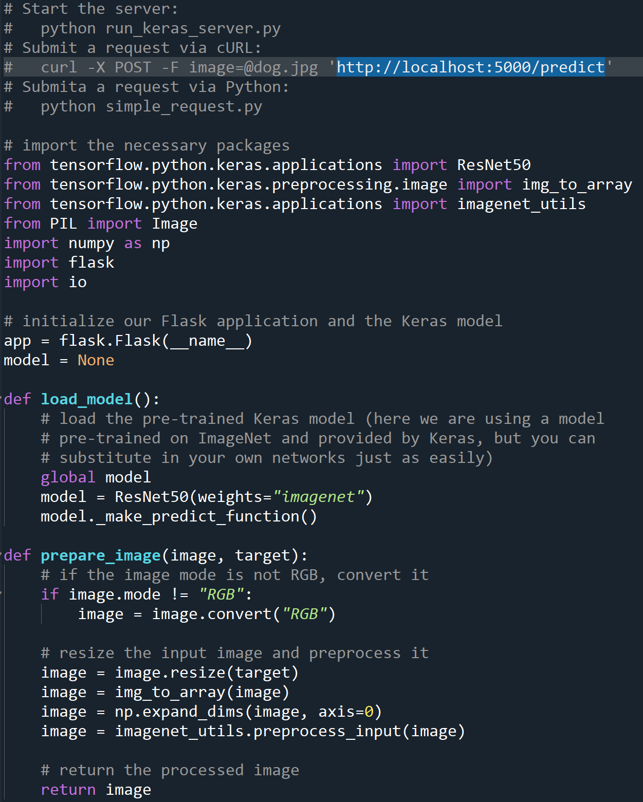
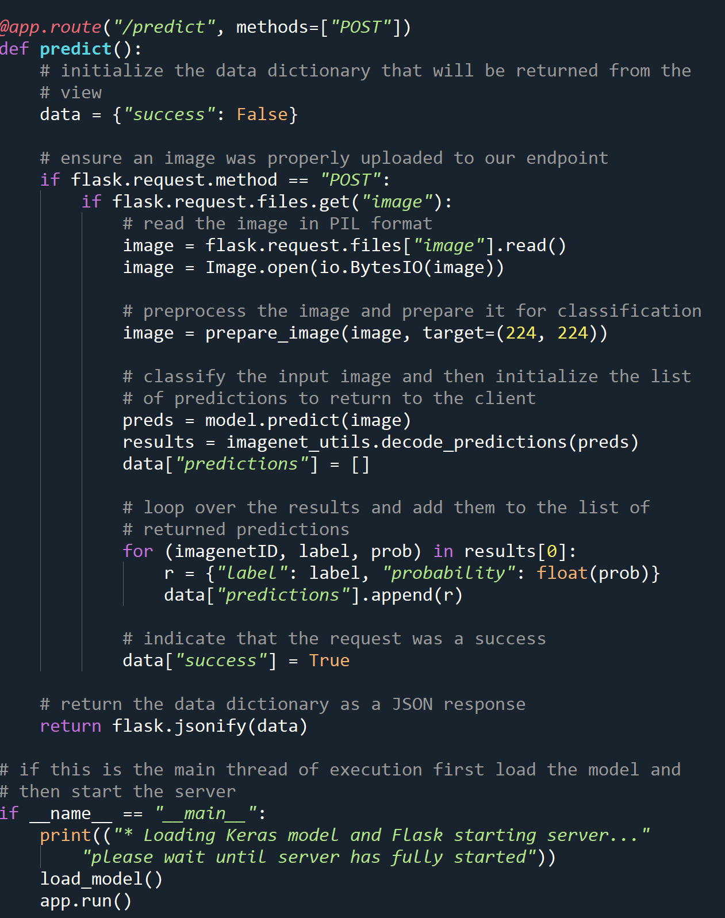
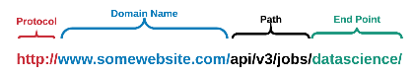
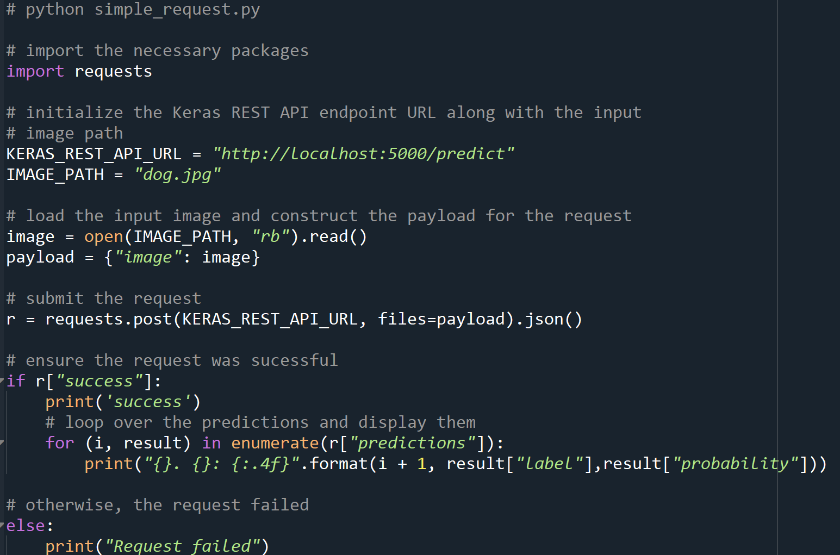
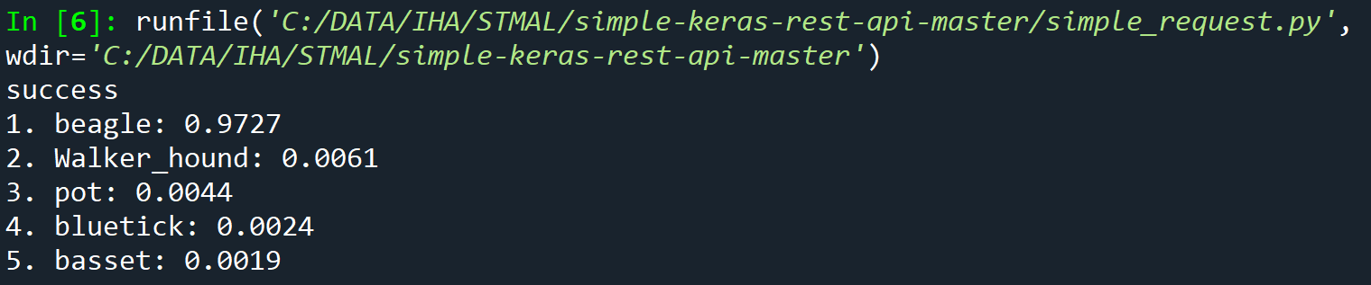
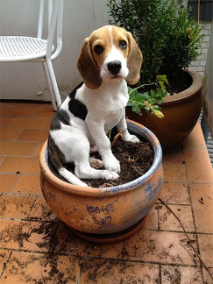
DEPLOYMENT 101
BASIC WEB REST API
3
1
2
https://blog.keras.io/building-a-simple-keras-deep-learning-rest-api.html

Slide 7
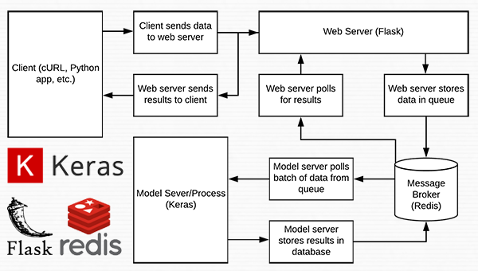
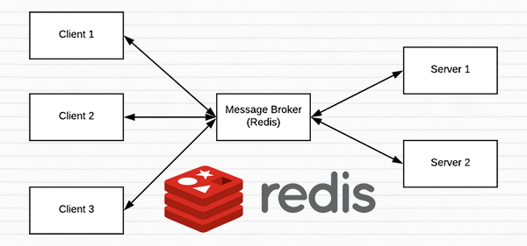
DEPLOYMENT 101
PRODUCTION WEB REST API
2
1
3
https://www.pyimagesearch.com/2018/01/29/scalable-keras-deep-learning-rest-api/

Slide 8
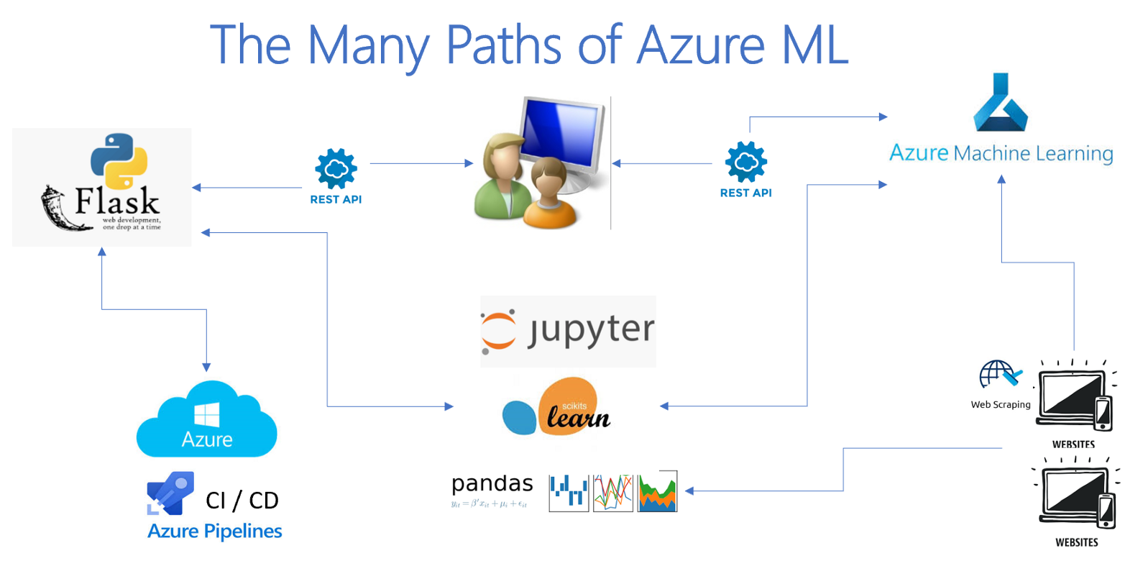
DEPLOYMENT 101
PRODUCTION WEB REST API
2
1
3
https://medium.com/microsoftazure/deploying-azure-machine-learning-containers-41bcb02a4e1b

Slide 9
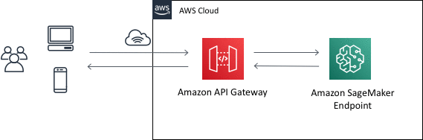
DEPLOYMENT 101
PRODUCTION WEB REST API
2
1
3

Slide 10

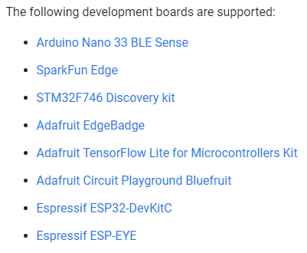
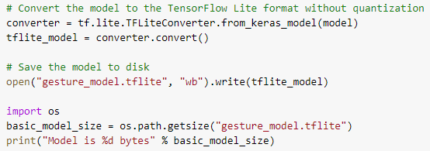
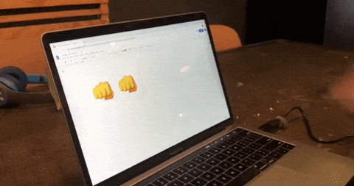
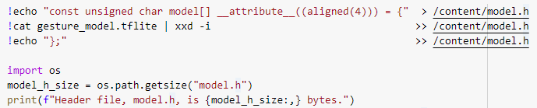
DEPLOYMENT 101
TENSORFLOW LITE FOR MICROCONTROLLERS
https://blog.arduino.cc/2019/10/15/get-started-with-machine-learning-on-arduino/

Slide 11
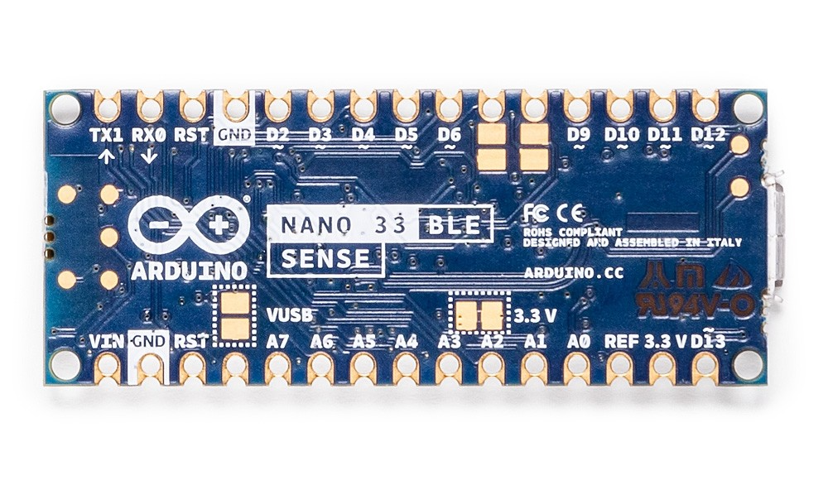
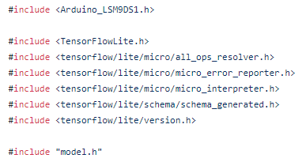
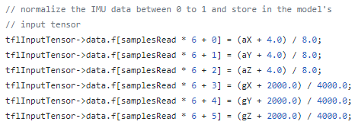
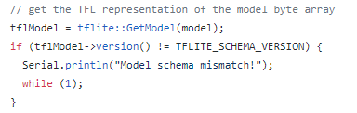
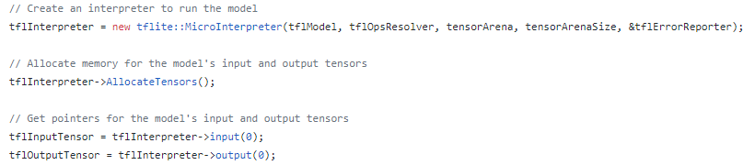
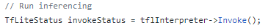
DEPLOYMENT 101
TENSORFLOW LITE FOR MICROCONTROLLERS
https://github.com/arduino/ArduinoTensorFlowLiteTutorials/blob/master/GestureToEmoji/ArduinoSketches/IMU_Classifier/IMU_Classifier.ino

Slide 12
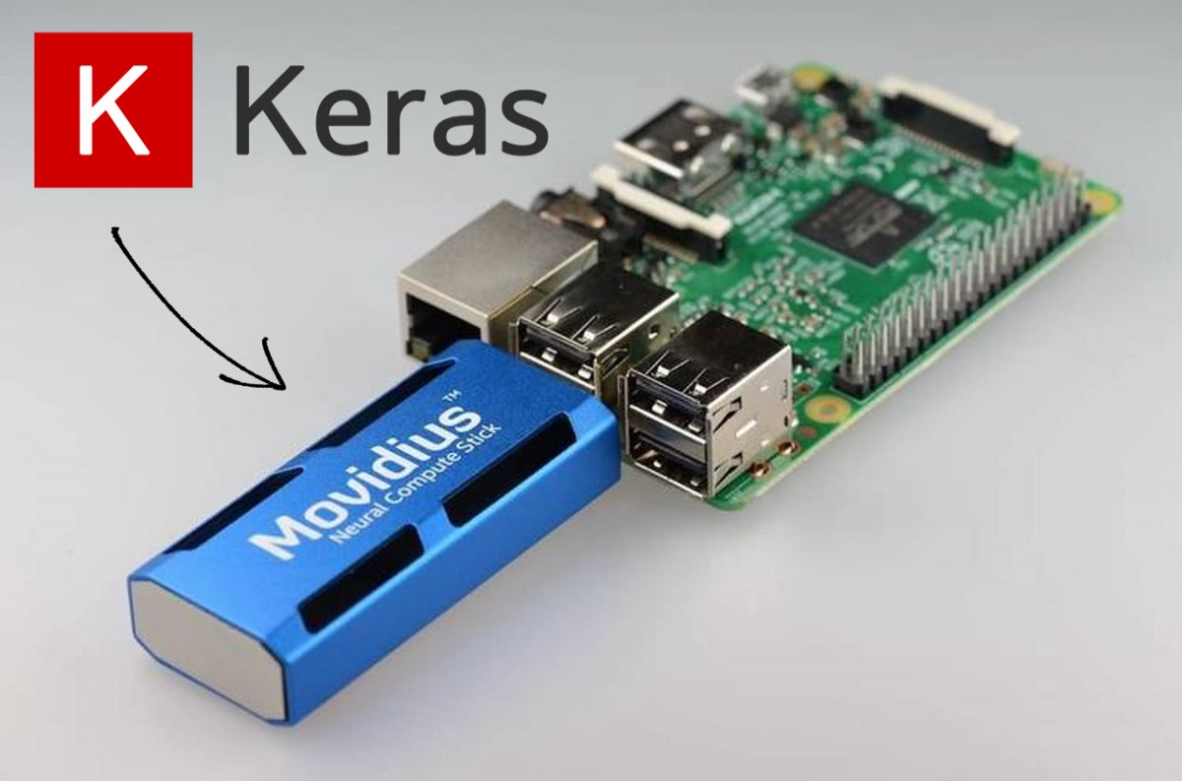
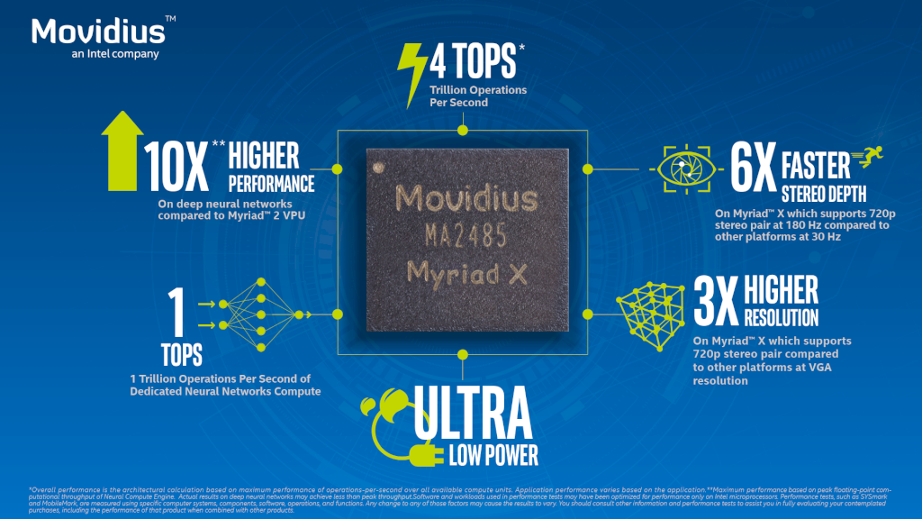
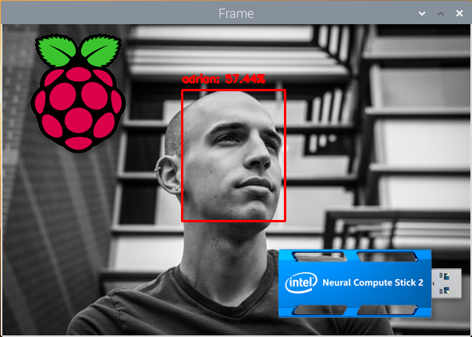
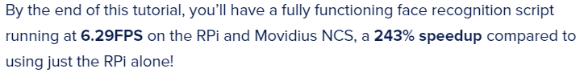
DEPLOYMENT 101
NEURAL COMPUTE STICKS FOR RPi
https://www.pyimagesearch.com/2020/01/06/raspberry-pi-and-movidius-ncs-face-recognition/

Slide 13
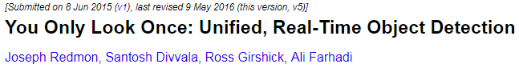
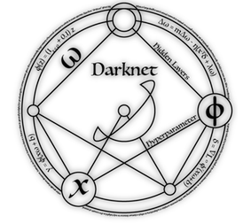
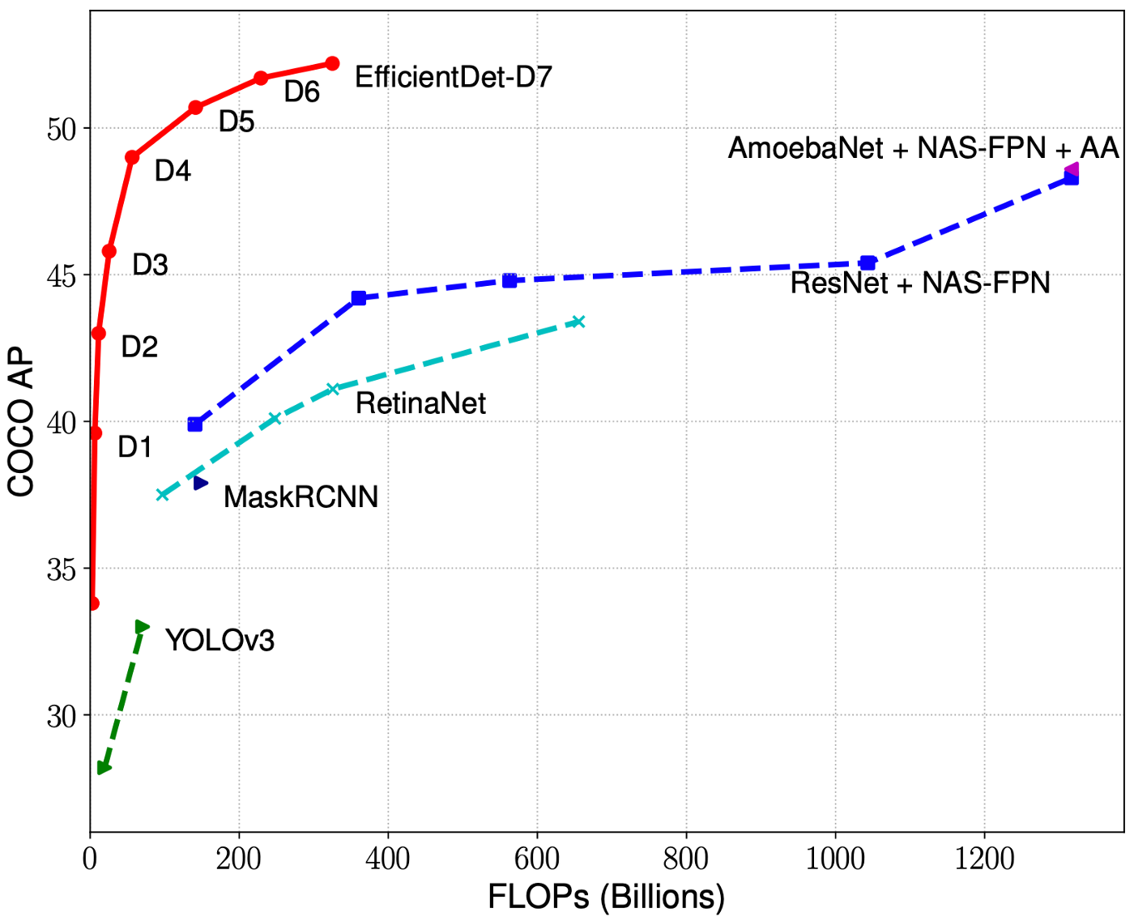
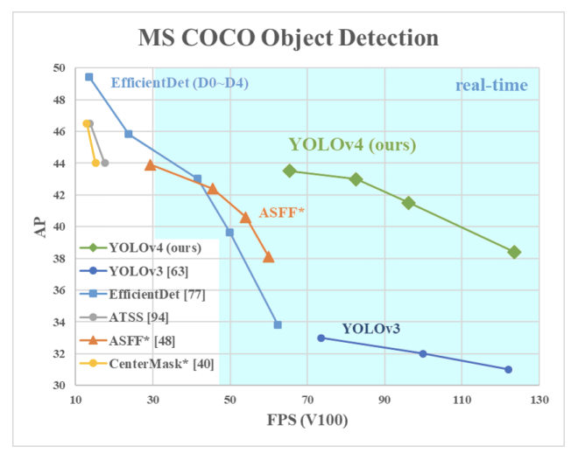
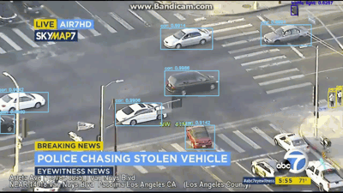
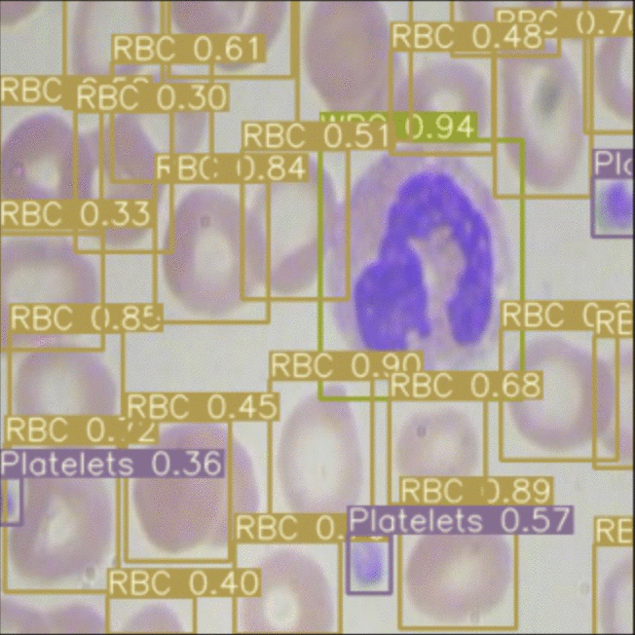
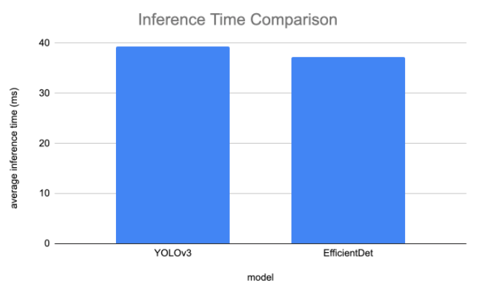
DEPLOYMENT 101
REAL-TIME OBJECT DETECTION
https://blog.roboflow.com/yolov3-versus-efficientdet-for-state-of-the-art-object-detection/

